Slide 1
PHYS 1502 Exam 1 Review

Slide 2
Coulomb's Law

Slide 4
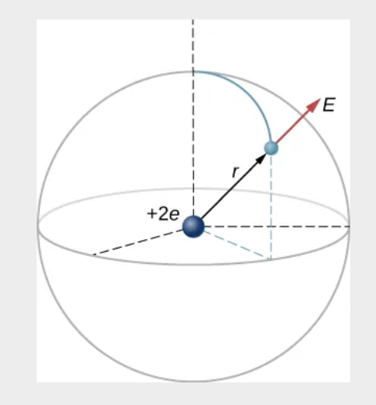
Electric Fields
In an ionized helium atom, the most probable distance between the nucleus and the electron is 𝑟=26.5×10−12m. What is the electric field due to the nucleus at the location of the electron?

Slide 6
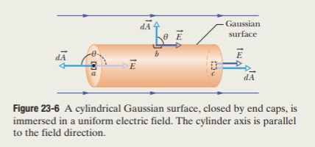
Electric Flux

Slide 8
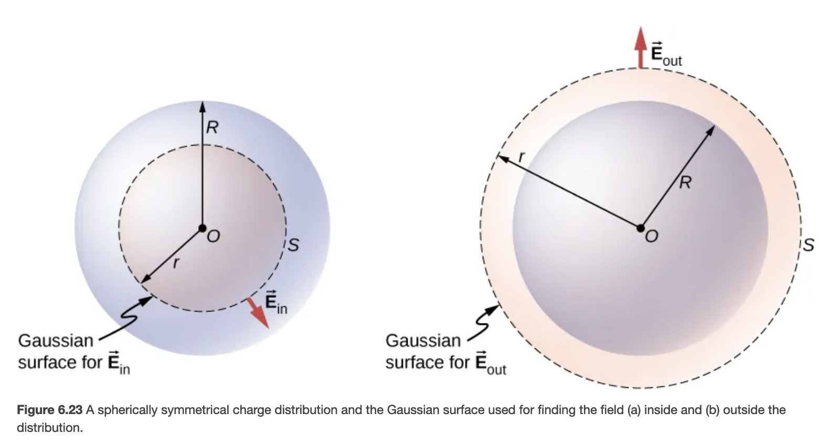
Gauss's Law
A sphere of radius R, such as that shown in Figure 6.23, has a uniform volume charge density 𝜌0. Find the electric field at a point outside the sphere and at a point inside the sphere.

Slide 10
Electric Potential

Slide 12
Capacitance
What is the capacitance of an empty parallel-plate capacitor with metal plates that each have an area of 1.00m2, separated by 1.00 mm? (b) How much charge is stored in this capacitor if a voltage of 3.00×103V is applied to it?

Slide 14
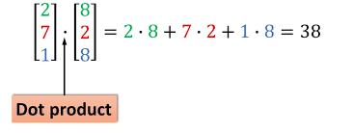
Concepts
k vs e0
k= 1.380649 × 10−23 joule per kelvin
Relation between average relative thermal energy of particles in a gas with the thermodynamic temperature of the gas.
e0 = 8.8541878128(13)×10−12 F⋅m−1
Electric field's capability to permeate a vacuum
Dot Product
Surface integrals

