Slide 1
PHYS 1501 Exam 1 Review

Slide 2
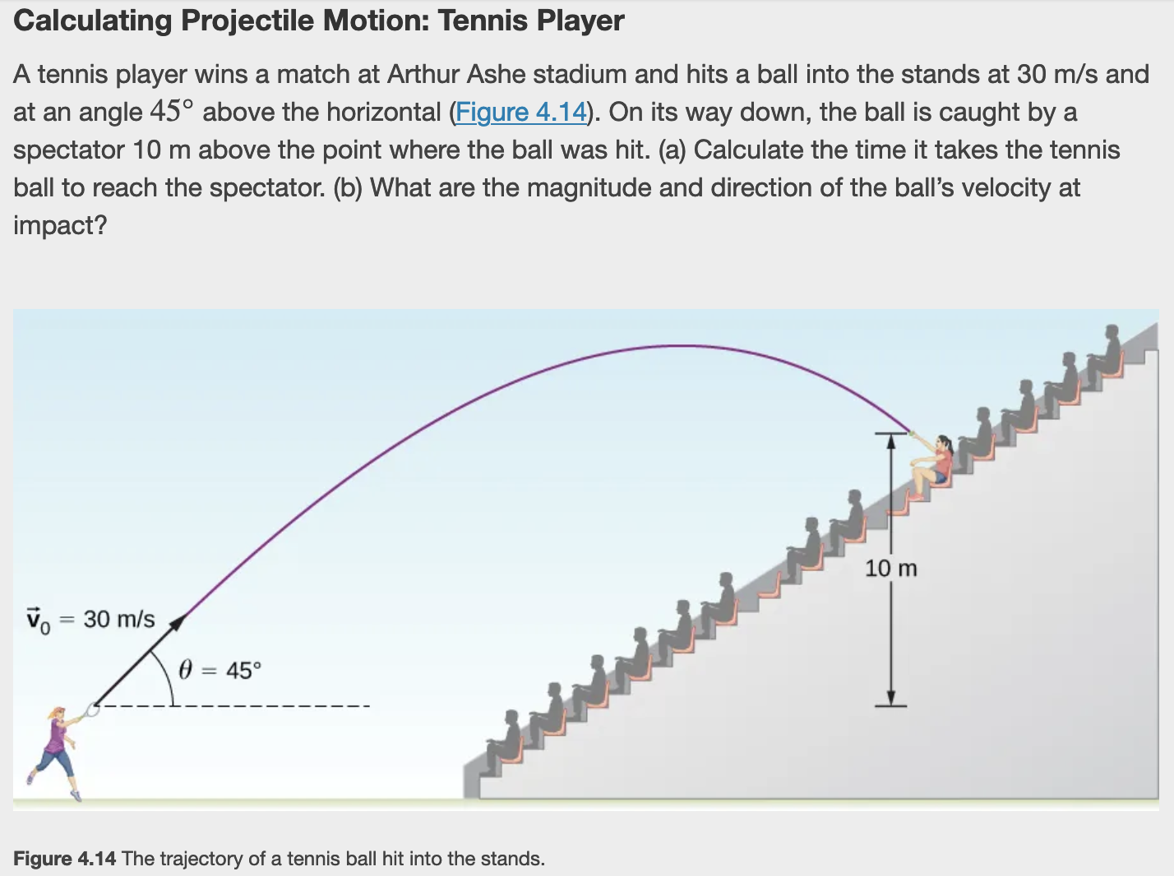
Projectile Motion

Slide 4
Relative and Circular Motion
A jet is flying at 134.1 m/s along a straight line and makes a turn along a circular path level with the ground. What does the radius of the circle have to be to produce a centripetal acceleration of 1 g on the pilot and jet toward the center of the circular trajectory?

Slide 6
Newton's Laws
When Does Newton’s First Law Apply to Your Car? Newton’s laws can be applied to all physical processes involving force and motion, including something as mundane as driving a car.
(a) Your car is parked outside your house. Does Newton’s first law apply in this situation? Why or why not?
(b) Your car moves at constant velocity down the street. Does Newton’s first law apply in this situation? Why or why not?

Slide 8
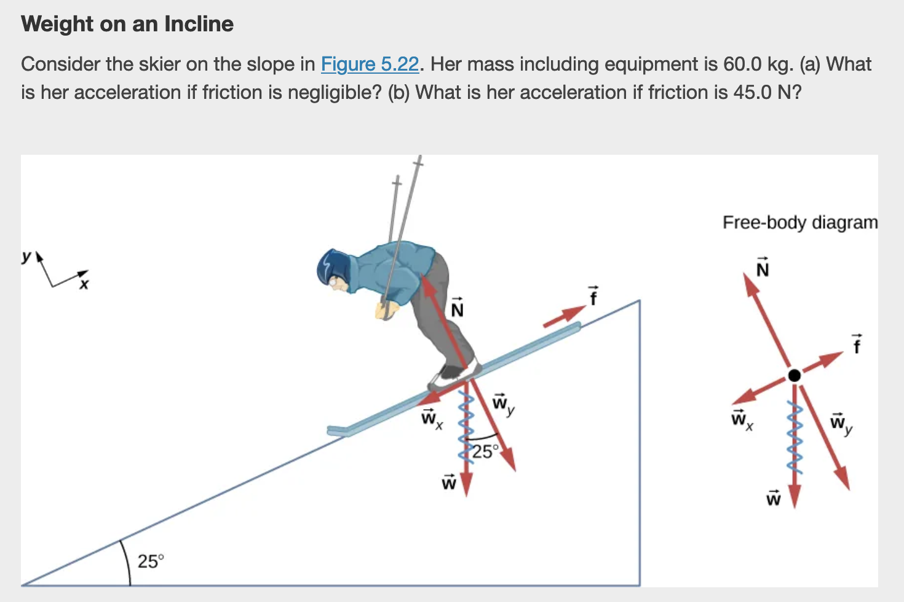
Free Body Diagrams

Slide 10
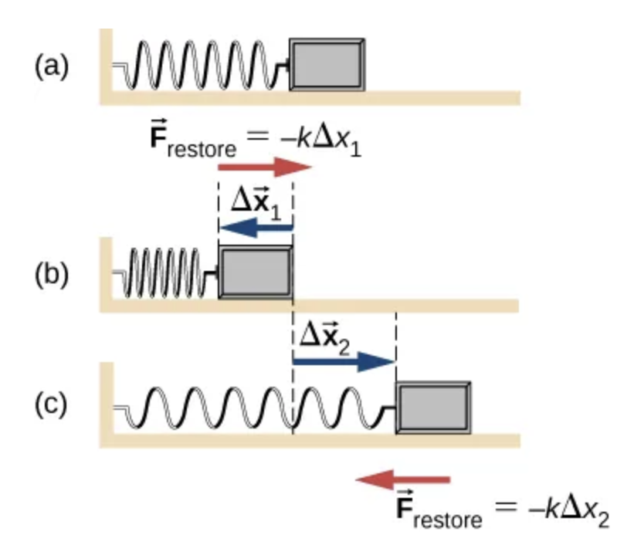
Springs and Friction

Slide 12
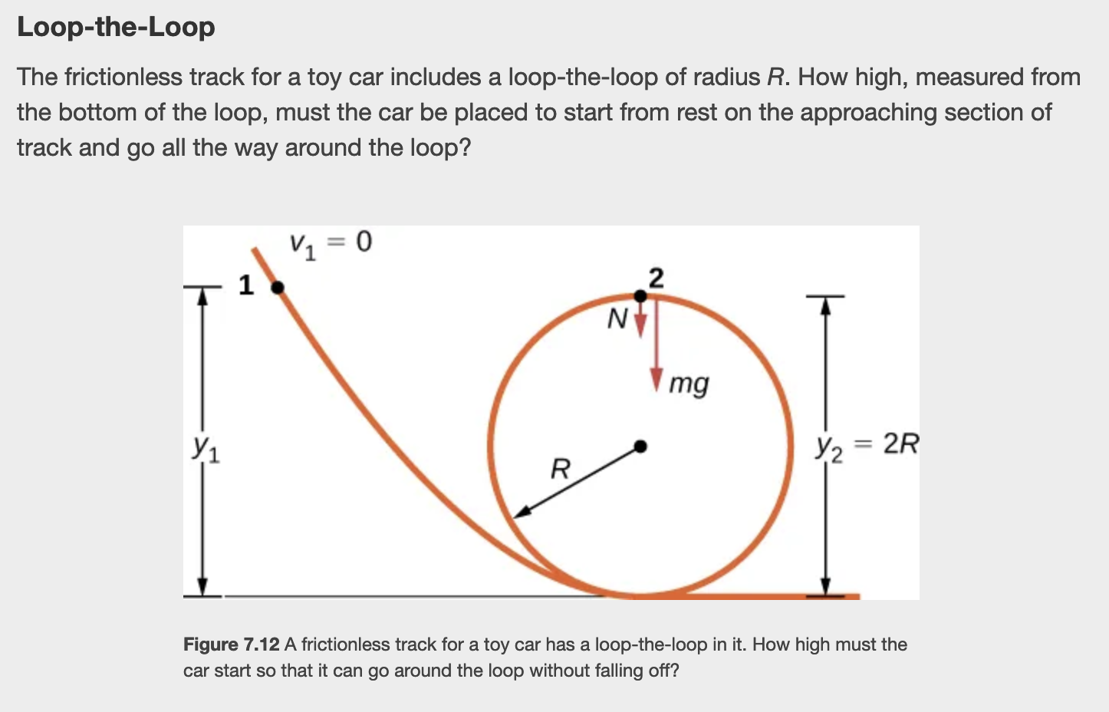
Work-Energy Theorem

